Slide 1
The Climate Changers
And Water Wars: Technocracy, Geoengineering,
And Replacing the Water Cycle
Presentation at the Red Pill Expo, Spokane, Washington. June 21-23, 2018

Slide 2
What is a Technocrat?
Tecnocracy is a movement started in the 1930s by engineers, scientists, and technicians that proposed replacement of capitalism with an energy-based economy. George Orwell believed that Technocracy would result in a Scientific Dictatorship. Technocrats seek to control all facets of global life through policies and technological methods. – Patrick Wood, author Technocracy Rising
Presentation at the Red Pill Expo, Spokane, Washington. June 21-23, 2018

Slide 3
TECHNOCRACY AND GEOENGINEERING
RUIN OCEAN
KILL TREES
KILL BACTERIA
ARTIFICIAL CLOUDS
GEOENGINEERING
Shut down the evaporation cycle (CLAW Process/Theory) and replace with boats and aircraft that increase water vapor in the sky
Stop trees from cleaning the air, removing CO2, and producing seeds that create clouds, use boats and aircraft to create clouds.
Kill frost creating bacteria that harm crops but are essential for cloud formation and rainfall.
Bunker fuel creates Ship Tracks (marine stratocumulus) and aircraft create Contrail-Induced Cirrus clouds.
Climate Engineering or Climate Intervention technology will alter rainfall patterns worldwide creating winners and losers.
CONTROL GLOBAL DISTRIBUTION OF WATER

Slide 4
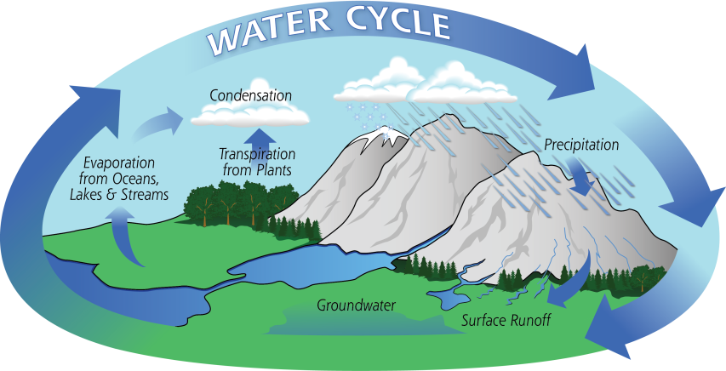
WATER CYCLE DEVASTATION
DESTRUCTION OF THE OCEAN
Plastic pollution, radioactive releases, and pollution from international shipping have lead to a shallowing of the uppermost layer of the ocean, loss of phytoplankton, and a reduction in evaporation. Less evaporation = less rainfall.
DESTRUCTION OF FORESTS
Clear cutting old-growth forests and removal of trees in rural areas are a serious problem. Trees not only reduce pollution and CO2 in the atmosphere, they produce cloud seeds that create rain. Tree reduction lead to the Dust Bowl in the 1930’s and history is repeating itself.
CLIMATE
CHANGE
DESTRUCTION OF BACTERIA
Bacteria like Pseudomonas syringae are natural cloud seeds. Introducing genetically modified Pseudomonas syringae (SynBio or synthetic biology) that does not produce ice and the use of industrial pesticides are killing off this natural source of rainfall.

Slide 5
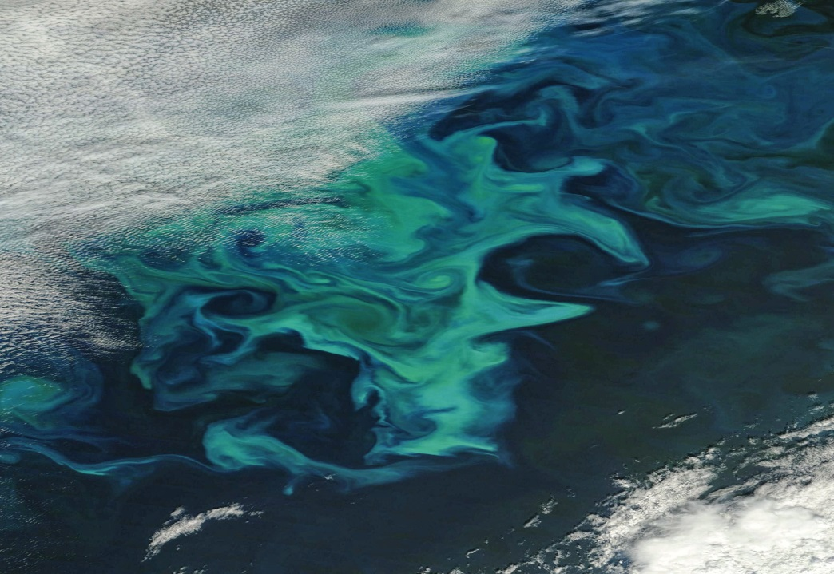
DESTROY THE OCEAN
Losses of diatoms were most significant in the North Pacific, the North Indian, and the Equatorial Indian oceans. The scientists’ study suggested that a likely cause was a shallowing of the mixed-layer by 5.9 feet. The mixed-layer is the uppermost layer of ocean water and a shallowing would reduce the nutrients available for phytoplankton growth. Why the mixed layer shallowed is still uncertain.
PLASTICS
FUKUSHIMA
SHIP TRACKS
NORMAL
BAD
WORST
PLASTICS
FUKUSHIMA
SHIP TRACKS
See the North Pacific Garbage Patch and other gyres which collect plastic.
Continuously leaking radioactive Cesium-137 since March 2011.
Creating artificial clouds which mimic what phytoplankton do naturally.

Slide 6
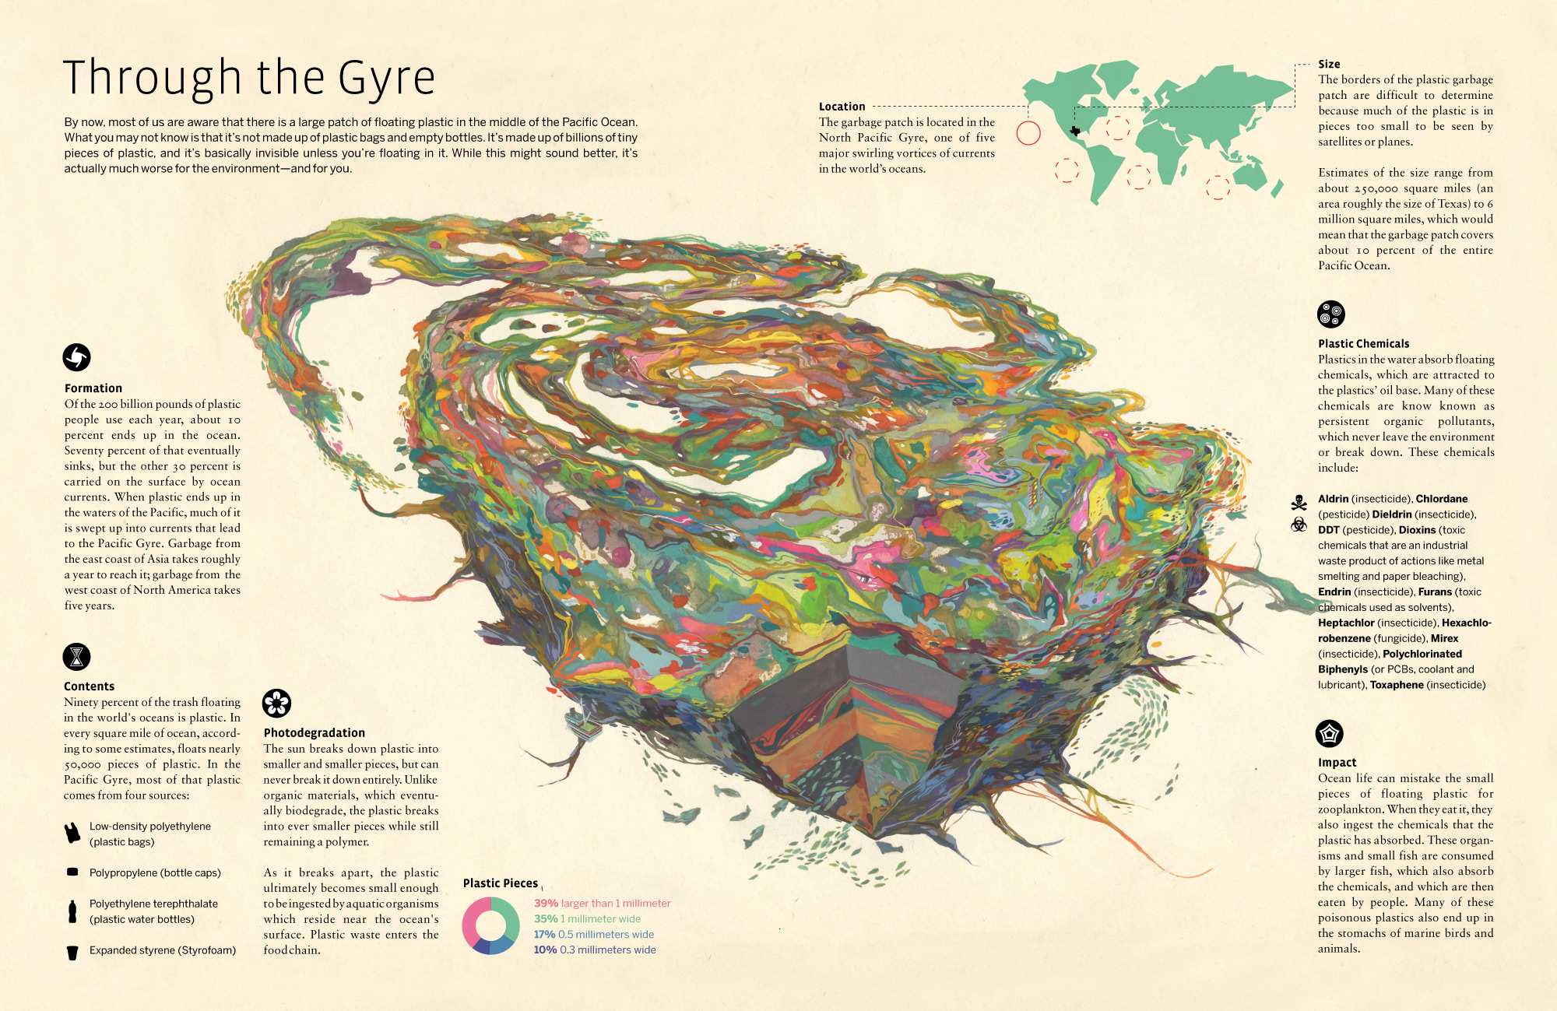

Slide 7
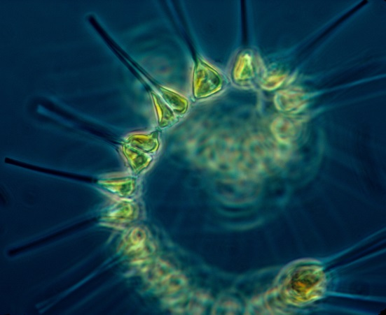
CLAW PROCESS
How phytoplankton naturally regulate global temperatures and make clouds
MORE CLOUDS
Increased cloud cover reflects sunlight back to space and leads to cooling.
COOLING
WARMING
Cooler temperatures lower phytoplankton, which results in less Dimethyl Sulfide (DMS) cloud seeds and less clouds.
Warmer temperatures and less clouds lead to phytoplankton growth, which means increased Dimethyl Sulfide (DMS) cloud seeds.
MORE SUNLIGHT
Fewer clouds means more sunlight reaches the surface of the Earth, temperatures rise, and phytoplankton begin to grow rapidly.

Slide 8
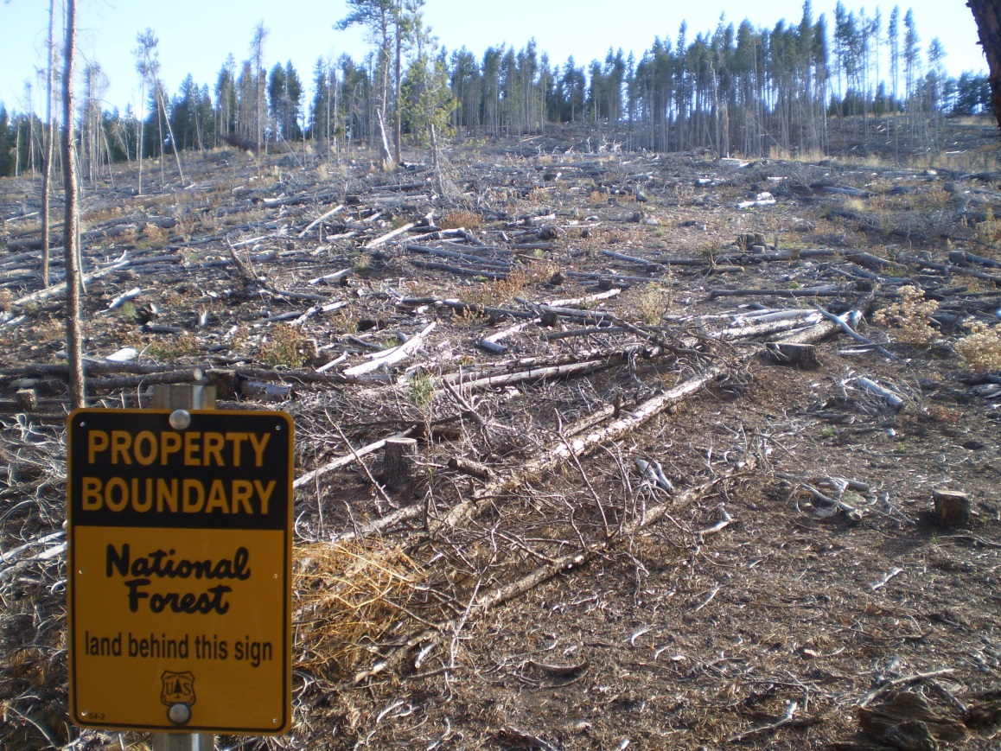
DESTROY THE FORESTS
Trees are being decimated and recent research shows that trees create clouds: CERN Cosmics Leaving Outdoor Droplets (CLOUD)
The results not only point to a cloudier past, but they also indicate a potentially cooler future: If Earth’s climate is less sensitive to rising carbon dioxide (CO2) levels, as the study suggests, future temperatures may not rise as quickly as predicted.
Some scientists have warned that measures such as scrubbing sulphur dioxide from coal-plant emissions could remove some of the beneficial cooling effect of clouds and boost global warming, but this may now be less of a concern because trees can seed clouds too. “What it means is, we don’t have to fear clean air,” says Stevens.
It is also interesting to speculate whether trees emit these compounds in part because there is a benefit to them in making their own climate, Kirkby says. “This really does touch on the Gaia hypothesis,” he says, referring to the theory that Earth’s life behaves as a single organism that tends to preserve itself. “It’s a beautiful mechanism for trees to control their environment.”
Presentation at the Red Pill Expo, Spokane, Washington. June 21-23, 2018

Slide 9
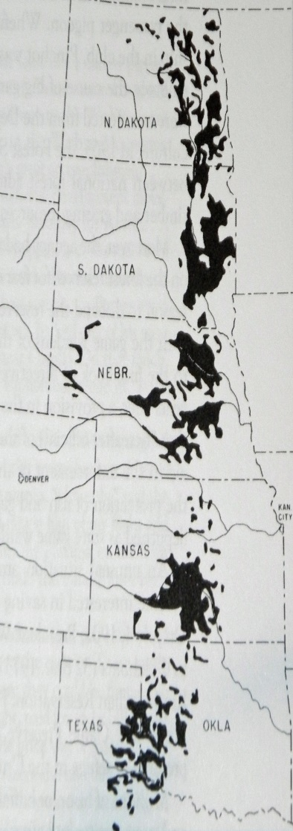
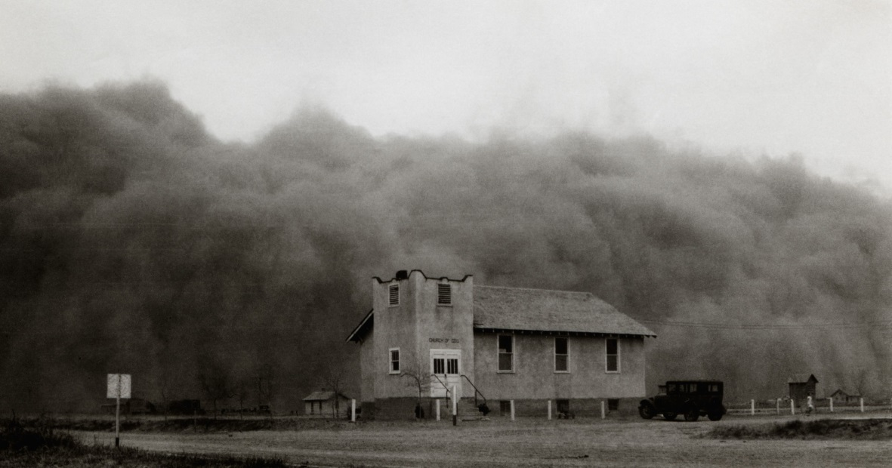
FIXING THE THE DUST BOWL
The Great Plains Shelterbelt
By 1942, 220 million trees had been planted, stretching out 18,600 miles in a 100-mile-wide zone from Canada to the Brazos River. Even as of 2007, “the federal response to the Dust Bowl, including the Prairie States Forestry Program which planted the Great Plains Shelterbelt and creation of the Soil Erosion Service, represents the largest and most-focused effort of the [U.S.] government to address an environmental problem.”
The Dust Bowl occurred due to massive deforestation, large farms, and bad agricultural practices.
We fixed Climate Change in the 1930s by planting trees. Those Shelterbelt trees are now being cut down.
220 Million Trees Planted
DUST BOWL
SHELTERBELT

Slide 10
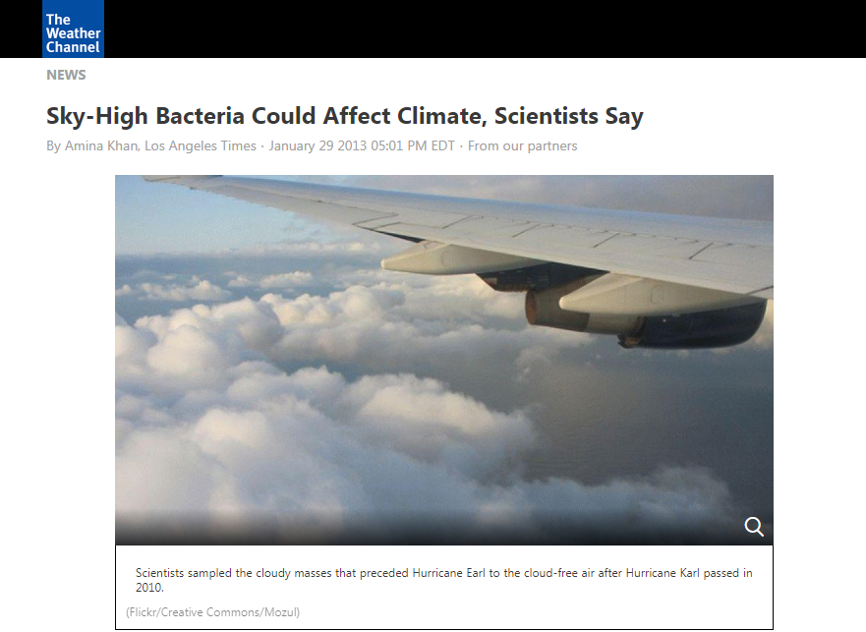
DESTROY BACTERIA
Pseudomonas syringae (P. syringae) bacteria plays major role in cloud formation. Genetically engineered version “ice-minus” released into wild.
Environmentalist hysteria intervened, and anti-science activists successfully fought the outdoor testing of ice-minus pseudomonas (trademarked as Frostban) for more than a year. In January 1986, they alleged that one-celled organisms can cause 'more death and destruction than all the wars we have ever fought,' that the research that created this technology is morally bankrupt, and that 'it is not for scientists, bureaucrats and industrialists to play God.' Jeremy Rifkin, of the Foundation on Economic Trends, alleged that the modified bacteria 'may decrease rainfall.‘ – Dr. Rick Shankman: Genetically Modified Weather: The Tale of FROSTBAN™ Synthetic Bacteria
https://climatex.mit.edu/genetically-modified-weather-tale-frostban%E2%84%A2-synthetic-bacteria
Presentation at the Red Pill Expo, Spokane, Washington. June 21-23, 2018

Slide 11
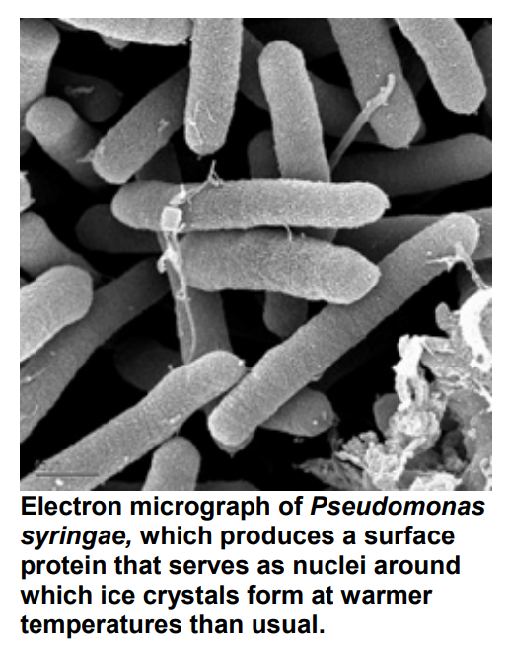
BACTERIAL CLOUD SEEDING
Recent discoveries show that “rain-making bacteria” are more efficient at forming these nuclei than inert particles, due to their larger size and surface area.
Minerals can only orient a few water molecules but bacterial proteins are big and can orient many simultaneously. Ski resorts exploit this property by using attenuated bacteria for the seeding of artificial snow. The older method of seeding clouds with silver iodide has been in use for over 60 years.
http://www.hardydiagnostics.com/wp-content/uploads/2016/05/Ice-Forming-Bacteria.pdf

Slide 13
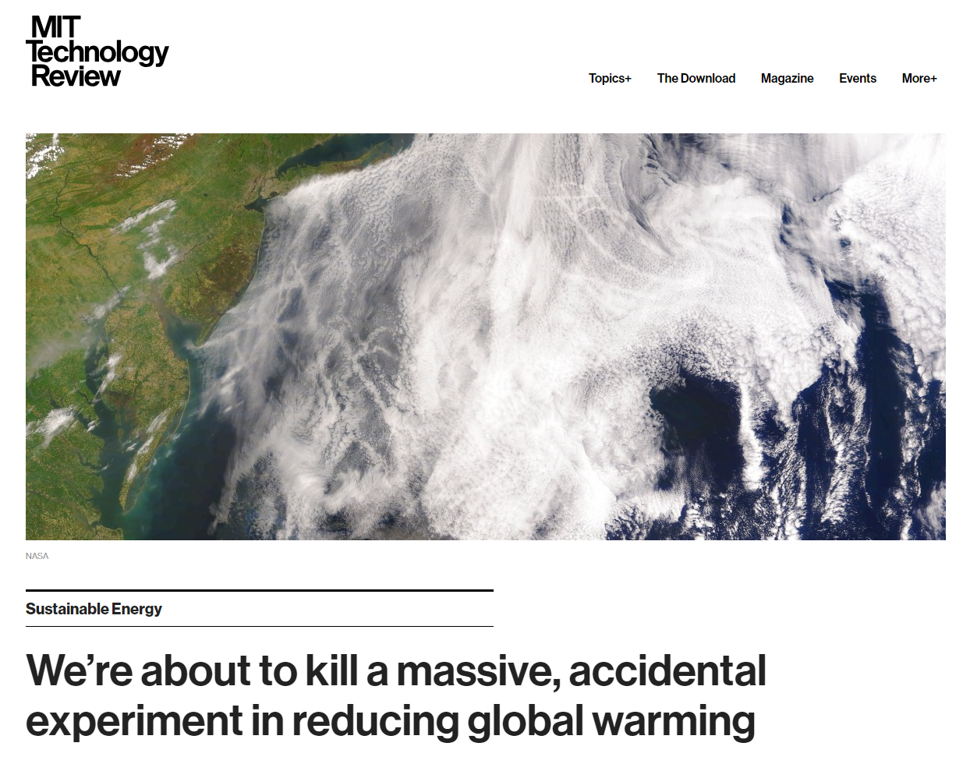
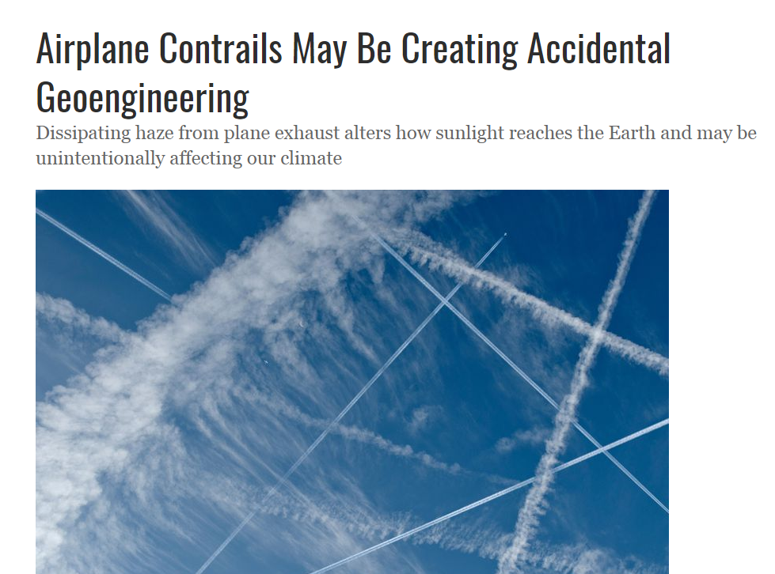
ARTIFICIAL CLOUDS
Technocrats have decided to replace natural cloud formation with technological fixes dubbed “Accidental Geoengineering”: Ship Tracks and Aircraft Contrail-Induced Cirrus Clouds.
https://climateviewer.com/2018/04/01/accidental-geoengineering-with-ship-tracks-contrails/

Slide 14
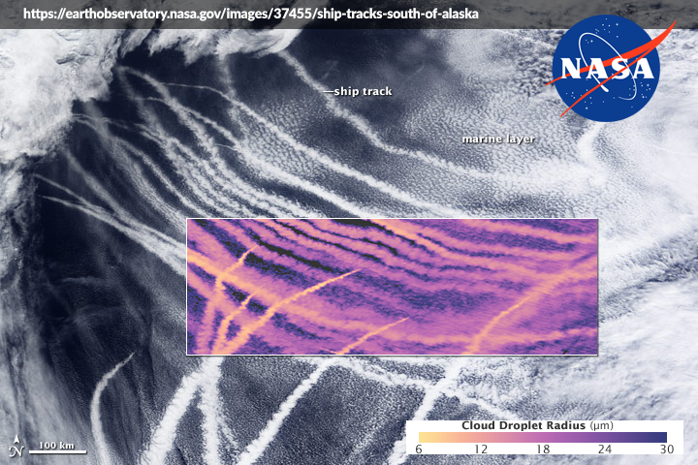
ARTIFICIAL CLOUDS: Ship Tracks
Try to maintain or even enhance the current cooling effect from currently emitted sulphate aerosols in the troposphere at mid to high northern latitudes. For example the regulation to ban bunker fuel for ships should be relaxed while encouraging continued use of bunker fuel where the resulting aerosol emissions might be beneficial. Reduction of sulphate aerosol ‘pollution’ will be unpopular with many environment groups, but the priority to cool the Arctic has to be established.
Arctic Methane Emergency Group
AMEG Strategic Plan 2012

Slide 15
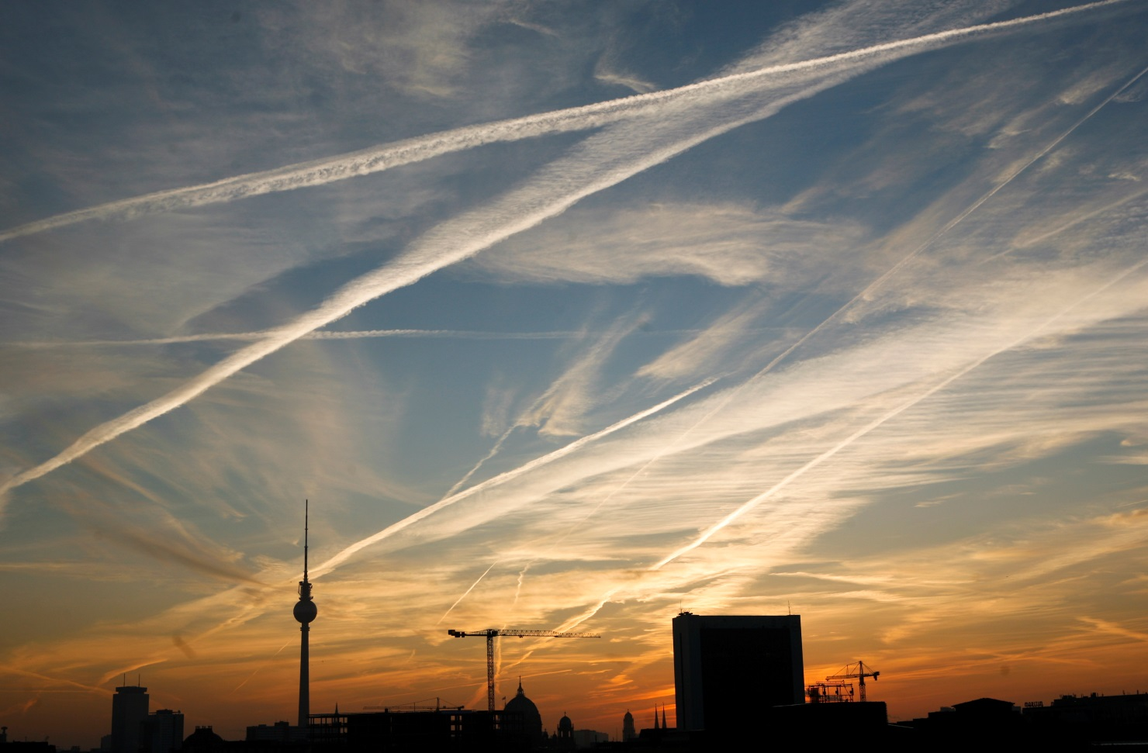
ARTIFICIAL CLOUDS: Contrails
Contrails during day cause cooling because of reflecting of sunlight back into space. During night, they trap infrared heat causing heating. So it is a balance between the two time intervals. We would like to have more CICs (contrail-induced cirrus clouds) during day and none during night.- Dr. Rangasayi Halthore FAA Scientist: We Want Clouds By Day, None By Night
If the time and place of seeding is selected with care, the climate effect of cirrus thinning can be enhanced. For that, only the long-wave warming effect of cirrus clouds should be targeted, and their solar effect should be avoided. This can be achieved if seeding is limited to high-latitude winters or to nighttime seeding. – Ken Caldeira
Climate Change and Geoengineering: Artificially Cooling Planet Earth by Thinning Cirrus Clouds

Slide 17
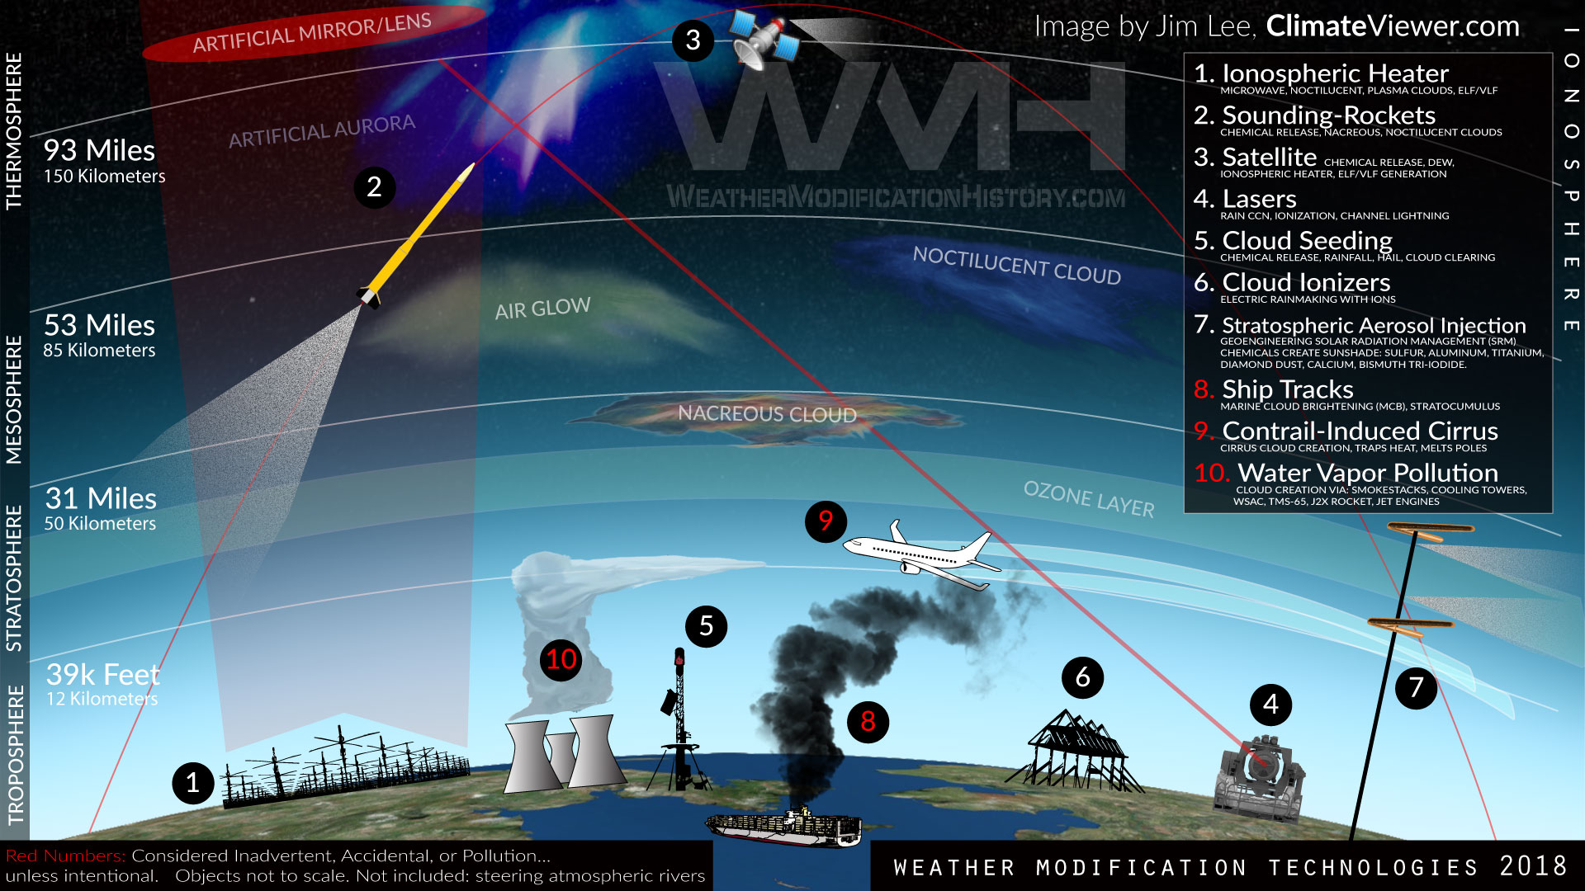

Slide 18
WEATHER MODIFICATION HISTORY
95%
Of people surveyed have no clue men attempt to control weather despite over 100 years of scientific experiments overhead. From the early days of rainmaking to weather warfare and future geoengineering plans, everyone is clueless.
PLUVICULTURE
1800-1946. Attempts at rainmaking using cannons, x-rays, electrified sand, and many other techniques.
CLOUD SEEDING
1946-Present. Cloud seeding can be used for rain enhancement, creating drought, decreasing hail, and has yet to prove scientific efficacy.
WEATHER WARFARE
Cloud seeding is the only technology that has documented evidence of being used as a weapon of war.
GEOENGINEERING
1994 – Present. Stratospheric Aerosol Injection for Solar Radiation Management. Global laws are currently being written to deal with the dead people as a result of altered rainfall patterns.

Slide 19
HOW CLOUD SEEDING WORKS
AIRCRAFT CLOUD SEEDING
Silver Iodide, Dry Ice, Urea (Fertilizer), Carbon Black Dust, and even Concrete are burned or dropped from planes into clouds to create or suppress rainfall.
SNOWPACK AUGMENTATION
DOWNWIND EFFECTS
Ground-based cloud seeding generators burn silver iodide in a mixture of acetone to do “Orographic Cloud Seeding” where wind carries chemicals up to mountain tops and creates artificial snow. These typically operate all winter in the USA..
Cloud seeding can lead to drought from “over-seeding” clouds, can increase storm intensity, increase hail and flood damage. These effects can lead to loss of crops, property, and life.

Slide 21
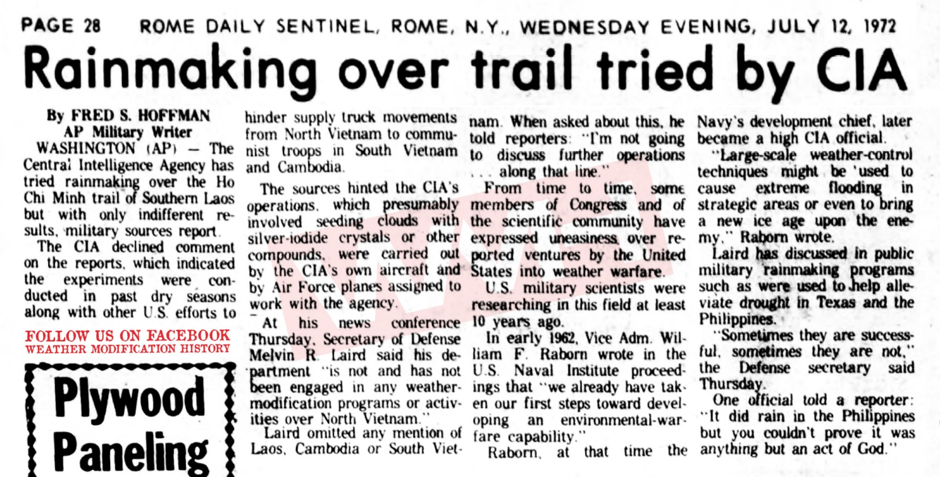
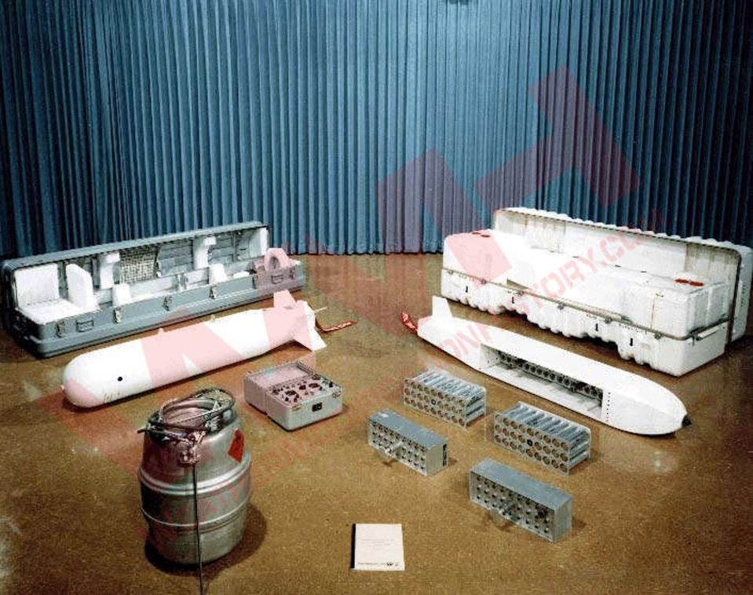
WEATHER WAFARE
“MAKE MUD, NOT WAR” OPERATION POPEYE, MARCH 20, 1967 - JULY 5, 1972. CLOUD SEEDING OVER VIETNAM
Operation Popeye first came to public light in March 1971, when reporter Jack Anderson published a story based on a secret 1967 memo from the Joint Chiefs of Staff to President Johnson. The memo read: “Laos operations – Continue as at present plus Pop Eye to reduce the trafficability [sic] along infiltration routes & Authorization requested to implement operational phase of weather modification process previously successful tested and evaluated in some area”. (US Senate, Subcommittee on Oceans and International Environment; 26 July 1972; p. 5).
https://weathermodificationhistory.com/operation-popeye-motorpool-intermediary-compatriot-weather-warfare-vietnam/

Slide 22
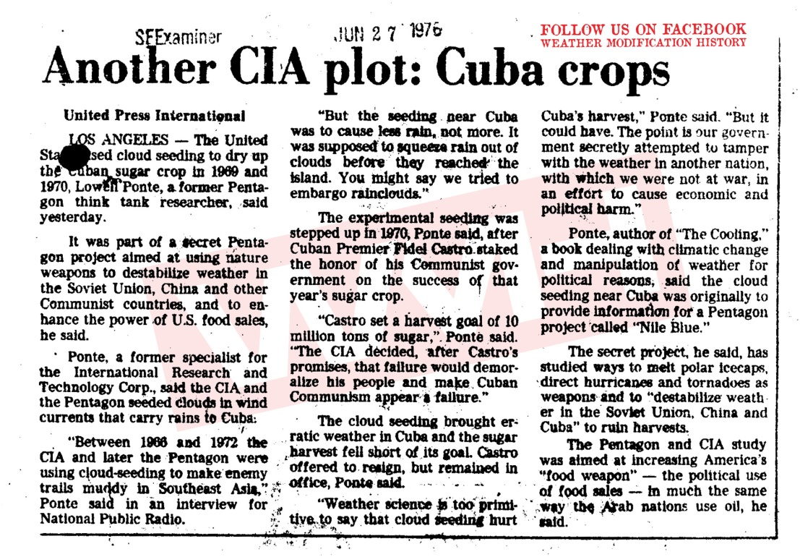
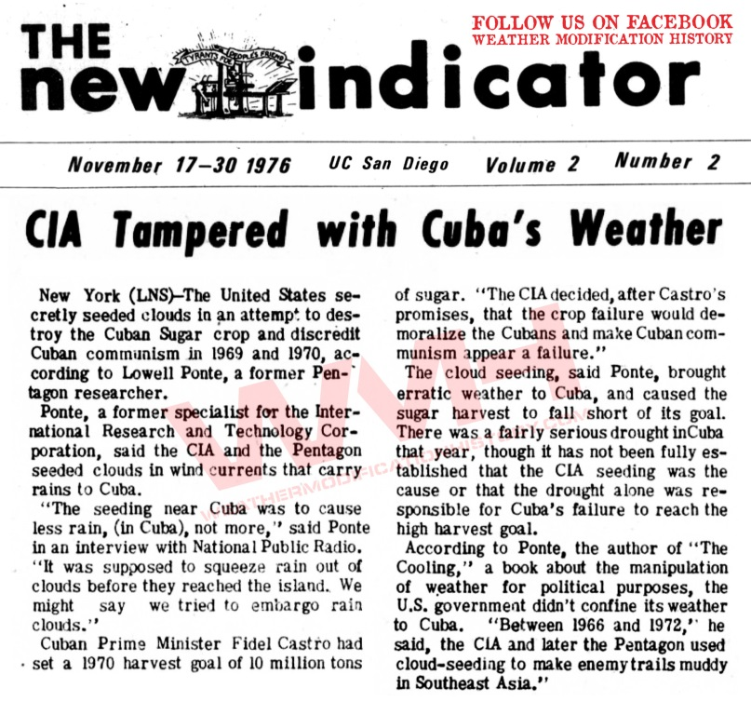
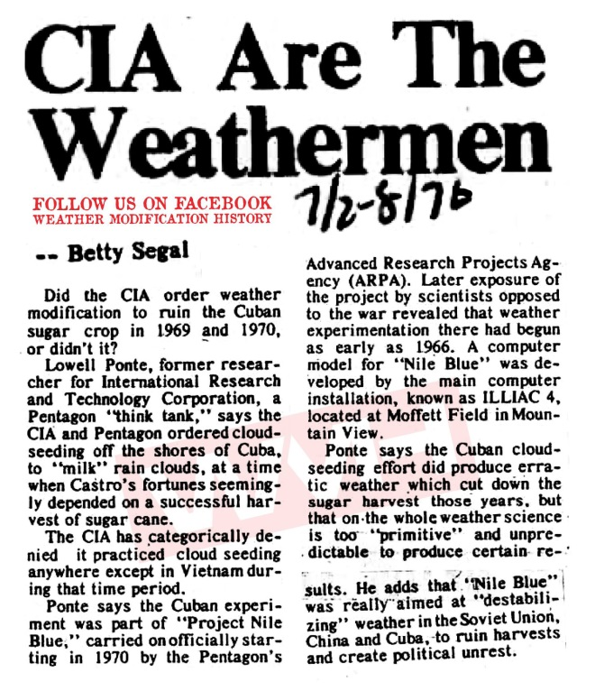
WEATHER WAFARE
CIA Project Nile Blue - Rain Embargo on Cuban Sugar Crops, 1969-1970
“But the seeding near Cuba was to cause less rain, not more. It was supposed to squeeze rain out of clouds before they reached the island. You might say we tried to embargo rainclouds.”
https://weathermodificationhistory.com/cia-project-nile-blue-rain-embargo-cuban-sugar-crops/

Slide 23
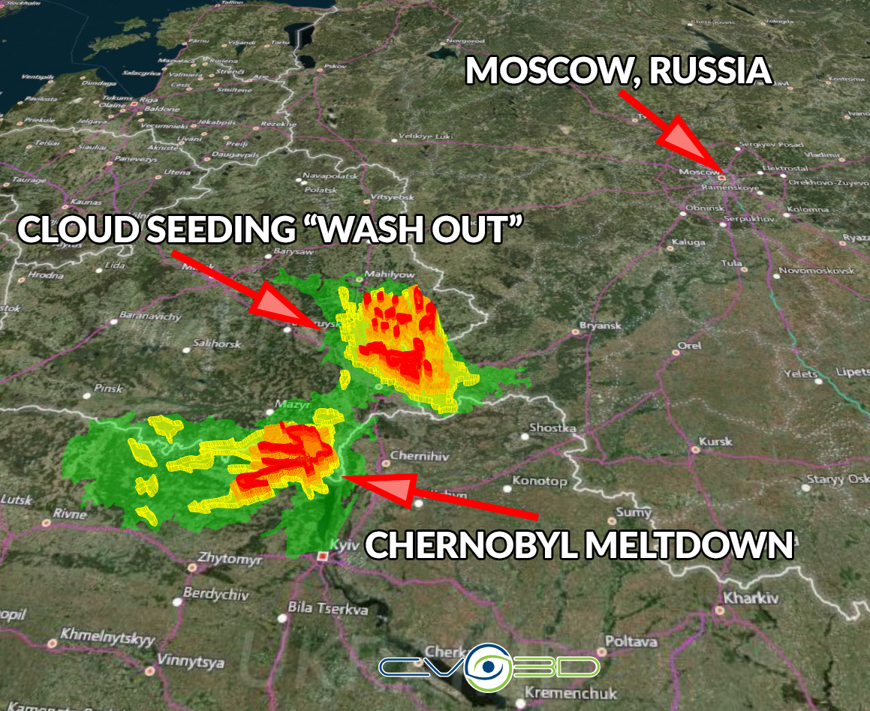
WEATHER MODIFICATION
REDUCING RAINFALL
‘How we made the Chernobyl rain’
April 22, 2007
Major Aleksei Grushin repeatedly took to the skies above Chernobyl and Belarus and used artillery shells filled with silver iodide to make rain clouds that would "wash out" radioactive particles drifting towards densely populated cities.
The seeding of 30 kg or more of coarse-dispersion powders (per cloud top) resulted in the destruction of single-cell isolated clouds within 10-20 minutes and frontal ones within 30-35 minutes.
https://climateviewer.com/2018/07/08/thai-cave-rescue-cloud-seeding-stop-monsoon/

Slide 24
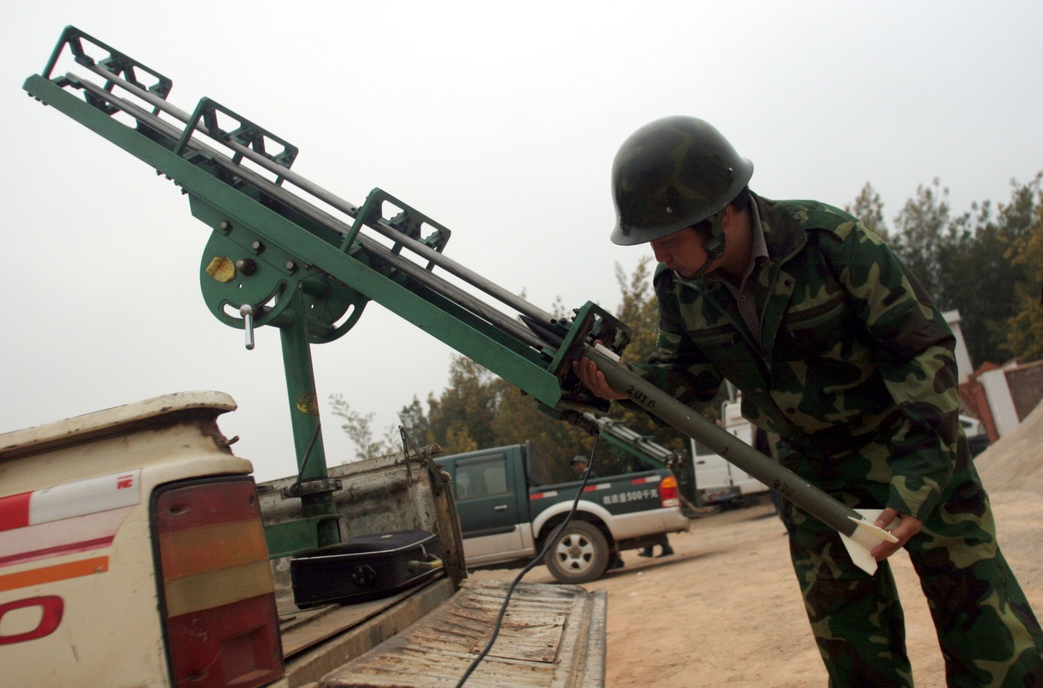
WEATHER MODIFICATION
REDUCING RAINFALL
Weather Engineering in China (Olympics)
March 25, 2008
Then, using their two aircraft and an array of twenty artillery and rocket-launch sites around Beijing, the city’s weather engineers will shoot and spray silver iodide and dry ice into incoming clouds that are still far enough away that their rain can be flushed out before they reach the stadium.
Finally, any rain-heavy clouds that near the Bird’s Nest will be seeded with chemicals to shrink droplets so that rain won’t fall until those clouds have passed over. Zhang Qian, head of Beijing’s Weather Modification Office, explains, “We use a coolant made from liquid nitrogen to increase the number of droplets while decreasing their average size. As a result, the smaller droplets are less likely to fall, and precipitation can be reduced.”
https://climateviewer.com/2018/07/08/thai-cave-rescue-cloud-seeding-stop-monsoon/

Slide 26
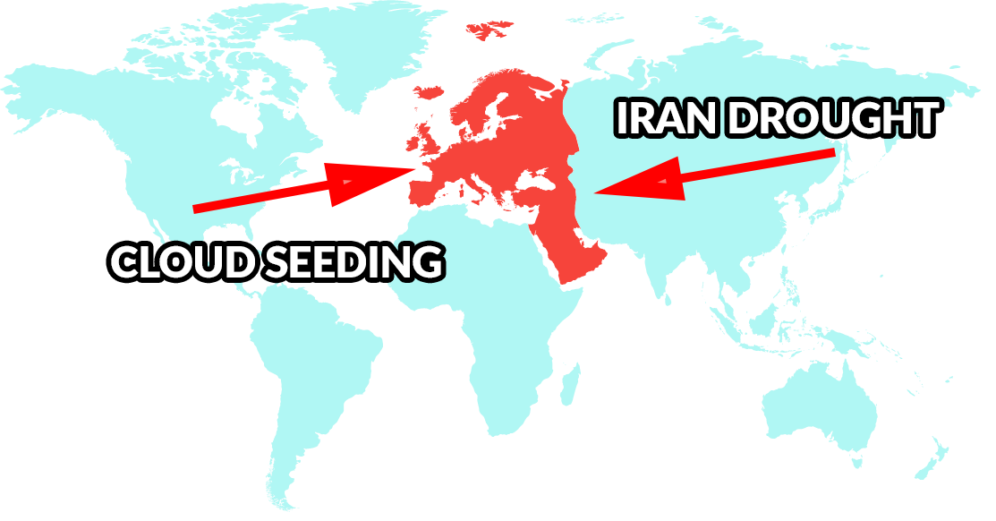
WEATHER MODIFICATION
REDUCING RAINFALL
Iran Accuses Israel of Cloud Theft
JULY 2, 2018
"Joint teams from Israel and one of the neighboring countries make the clouds entering into Iran barren. Moreover, we are faced with the cases of cloud theft and snow theft,"
Brigadier General Gholam Reza Jalali, head of Iran's Civil Defense Organization
https://climateviewer.com/2018/07/03/iran-accuses-israel-of-cloud-theft-weather-warfare-cia-cuban-rain-embargo/

Slide 27
GEOENGINEERING PUBLIC ACCEPTANCE
“The emissions and the climate change that we’re causing with that is already a massive experiment on our world that we don’t really know the outcome of. So I don’t think we should start another set of experiments and go into geoengineering. I think we should get our act together and reduce our emissions.”
U.N. Assistant Secretary-General Janos Pasztor
LEGAL GLOBAL DEPLOYMENT
Gain control of Earth’s thermostat and alter rainfall patterns worldwide: OWN THE WATER.
FIELD EXPERIMENTS
“Begin” testing geoengineering technology and gauge public response. SEE: David Keith, SCOPEX
GEOENGINEERING GOVERNANCE
Write laws to exempt technocrat scientists from legal liability.
“ACCIDENTAL GEOENGINEERING”
Begin geoengineering, climate engineering, or climate intervention using pollution sources that create clouds, call it an accident.

Slide 28
TECHNOCRACY AND CONTROL OF WEATHER
TECHNOCRATS
SCIENTISTS
UNIVERSITIES
GLOBAL GOVERNANCE
CLIMATE CHANGE
WATER WARS
MILITARY
Presentation at the Red Pill Expo, Spokane, Washington. June 21-23, 2018

Slide 29
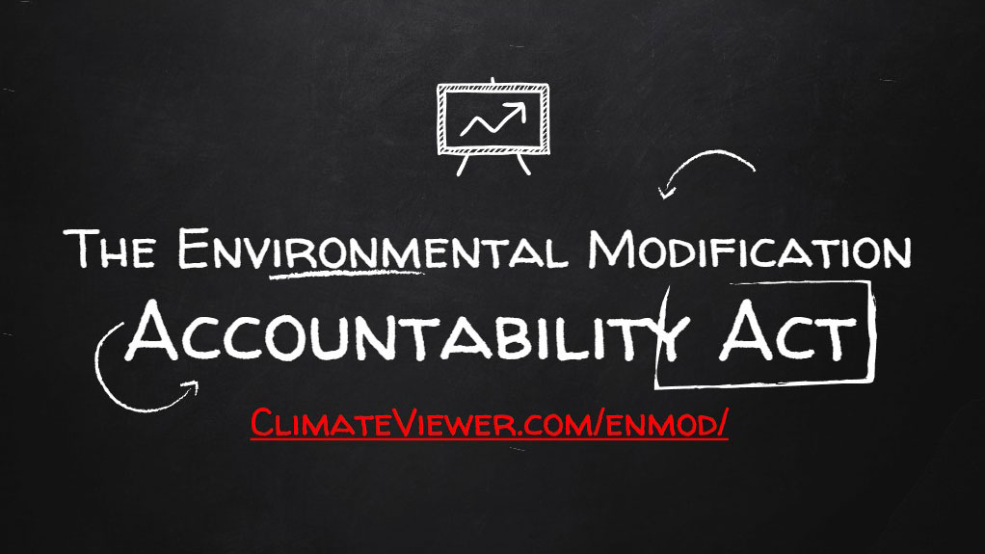

Slide 30
James Franklin Lee Jr.
ClimateViewer News, LLC
1637 North Main St.
Sumter, South Carolina 29153
+1 (803) 450-4305 jim@climateviewer.com Skype: rezn8d climateviewer.com
climateviewer.org
weathermodificationhistory.com
THIS PRESENTATION MAY BE FREELY DOWNLOADED AND DISTRIBUTED FROM: CLIMATEVIEWER.COM/GEOENGINEERING
Presentation at the Red Pill Expo, Spokane, Washington. June 21-23, 2018

