Slide 1
The
Angels
Proposal

Slide 2
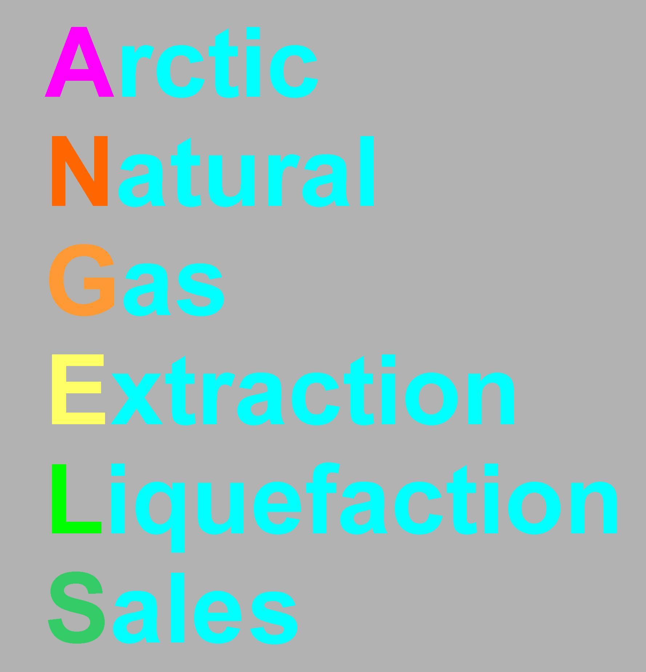

Slide 3
A Proposal for the Prevention of Arctic Methane Induced Catastrophic Global Climate Change by Extraction of Methane from beneath the Permafrost - Arctic Methane Hydrates and its Storage and Sale as a Subsidized "Green Gas“ Energy Source

Slide 4
Methane hydrates (clathrates) exist on the Arctic submarine shelf and slope where they are stabilized by the low temperatures and they have a continuous cap of frozen permafrost which normally prevents methane escape (Figure 1). However recent research has shown that millions of tons of methane are already being released in the Siberian Arctic through perforated zones in the subsea permafrost cap with the concentrations reaching up to 100 times the normal, such as in the discharge region of the Lena River and the junction of the Laptev and East Siberian Seas (Shakova et al. 2010).

Slide 5
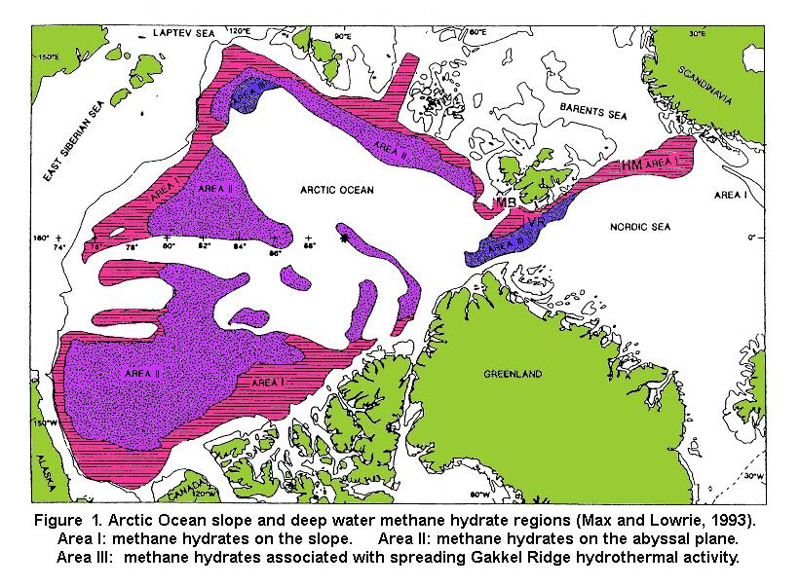

Slide 6
Mean methane concentrations in the Arctic atmosphere showed a striking anomalous buildup between November 1-10, 2008 and November 1-10, 2011 (Figure 2)(Yurganov 2012 in Carana, 2012). The surface temperature hotspots in the Arctic caused by global warming correlate well with the anomalous buildups of atmospheric methane in the Arctic (Figure 3 in Arctic feedbacks in Carana, 2012). This indicates that there is a strong correlation between the dissociation of Arctic subsea methane hydrates from the effects of globally warmed seawater and the increasing size and rate of eruptions of methane into the Arctic atmosphere.

Slide 7
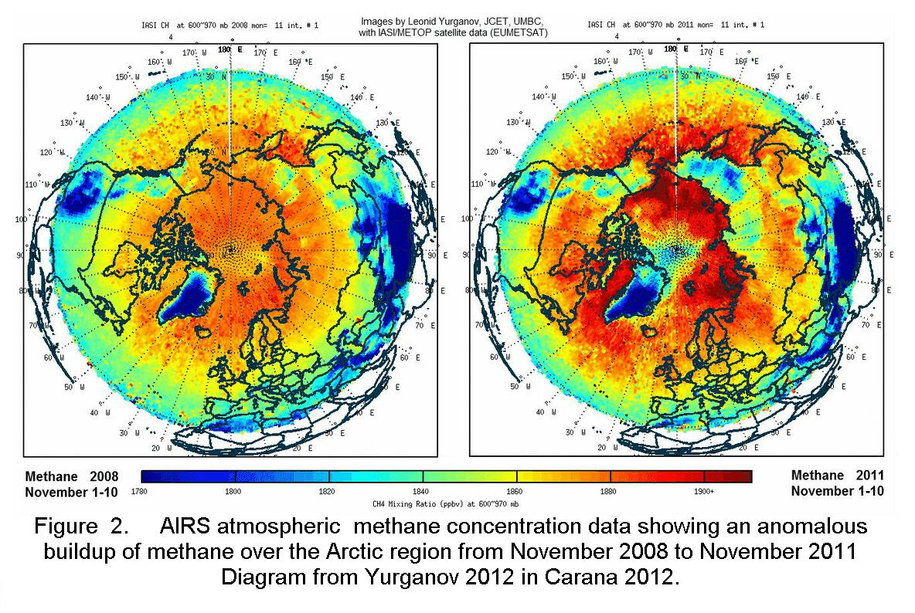

Slide 8
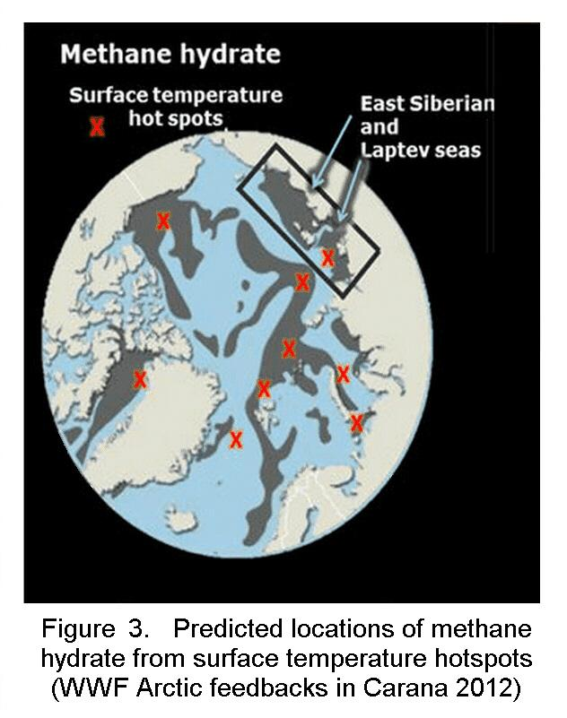

Slide 9
Methane eruption zones (torches) occur widely in the East Siberian Arctic Shelf (ESAS) (Shakova et al., 2008; 2010) but the largest and most extreme are confined to the region outside the ESAS where the Gakkel "mid ocean" ridge system intersects the methane hydrate rich shelf slope region at right angles (Figure 9 and Figure17). The wedge like opening and spreading of the Gakkel Ridge is putting the formations and overlying methane hydrate sediments under torsional stress and in the process activating the major strike slip faults that fan away from and thrust faults that radiate from this region (Figure 16).

Slide 10
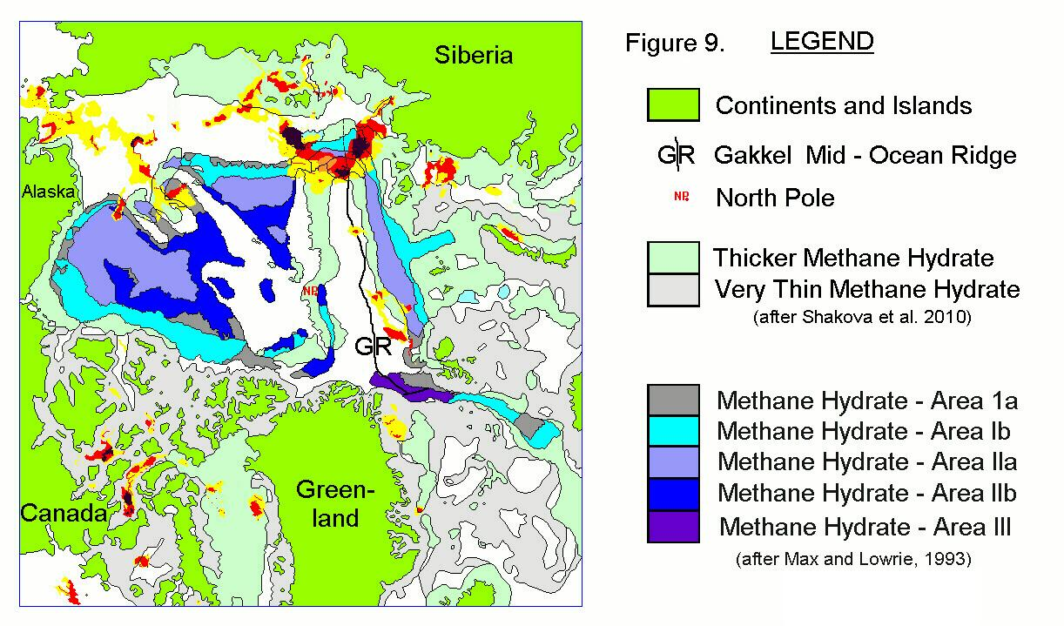

Slide 11
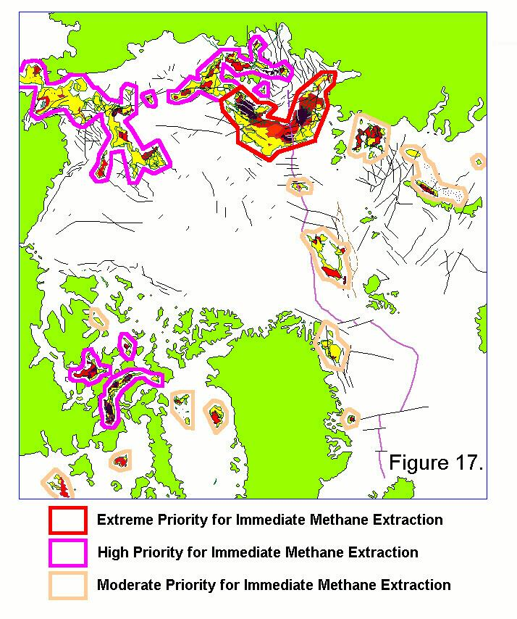

Slide 12
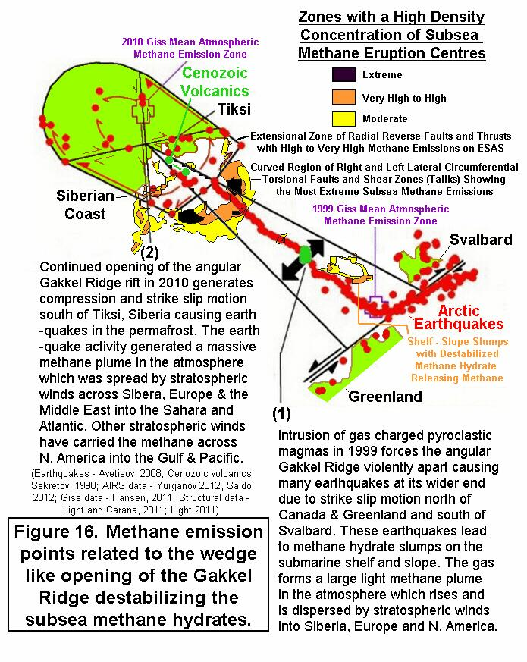

Slide 13
Light and Solana (2002) predicted that the north slope of the Barents - Laptev -East Siberian seas at the intersection of the slowly opening Gakkel Ridge would be especially vulnerable to slope failures where unstable methane hydrate would be affected by seismicity from earthquakes with magnitudes greater than 3.5 Richter and at depths of less than 30 km. Many earthquakes occur along the Gakkel Ridge often with magnitudes greater than 4 to 6 and at depths shallower than 10 km (Avetisov, 2008) continuously destabilizing the already unstable methane hydrates there (Figure 16).

Slide 15
Major and minor strike slip and normal faults form a continuous subterranean network around the Gakkel Ridge and are clearly charged with overpressured methane because methane gas is escaping from these fault lines many hundreds of km up dip and away from the subsea methane hydrate zones through which these fault zones pass (Figures 9 and Figure 18).

Slide 17
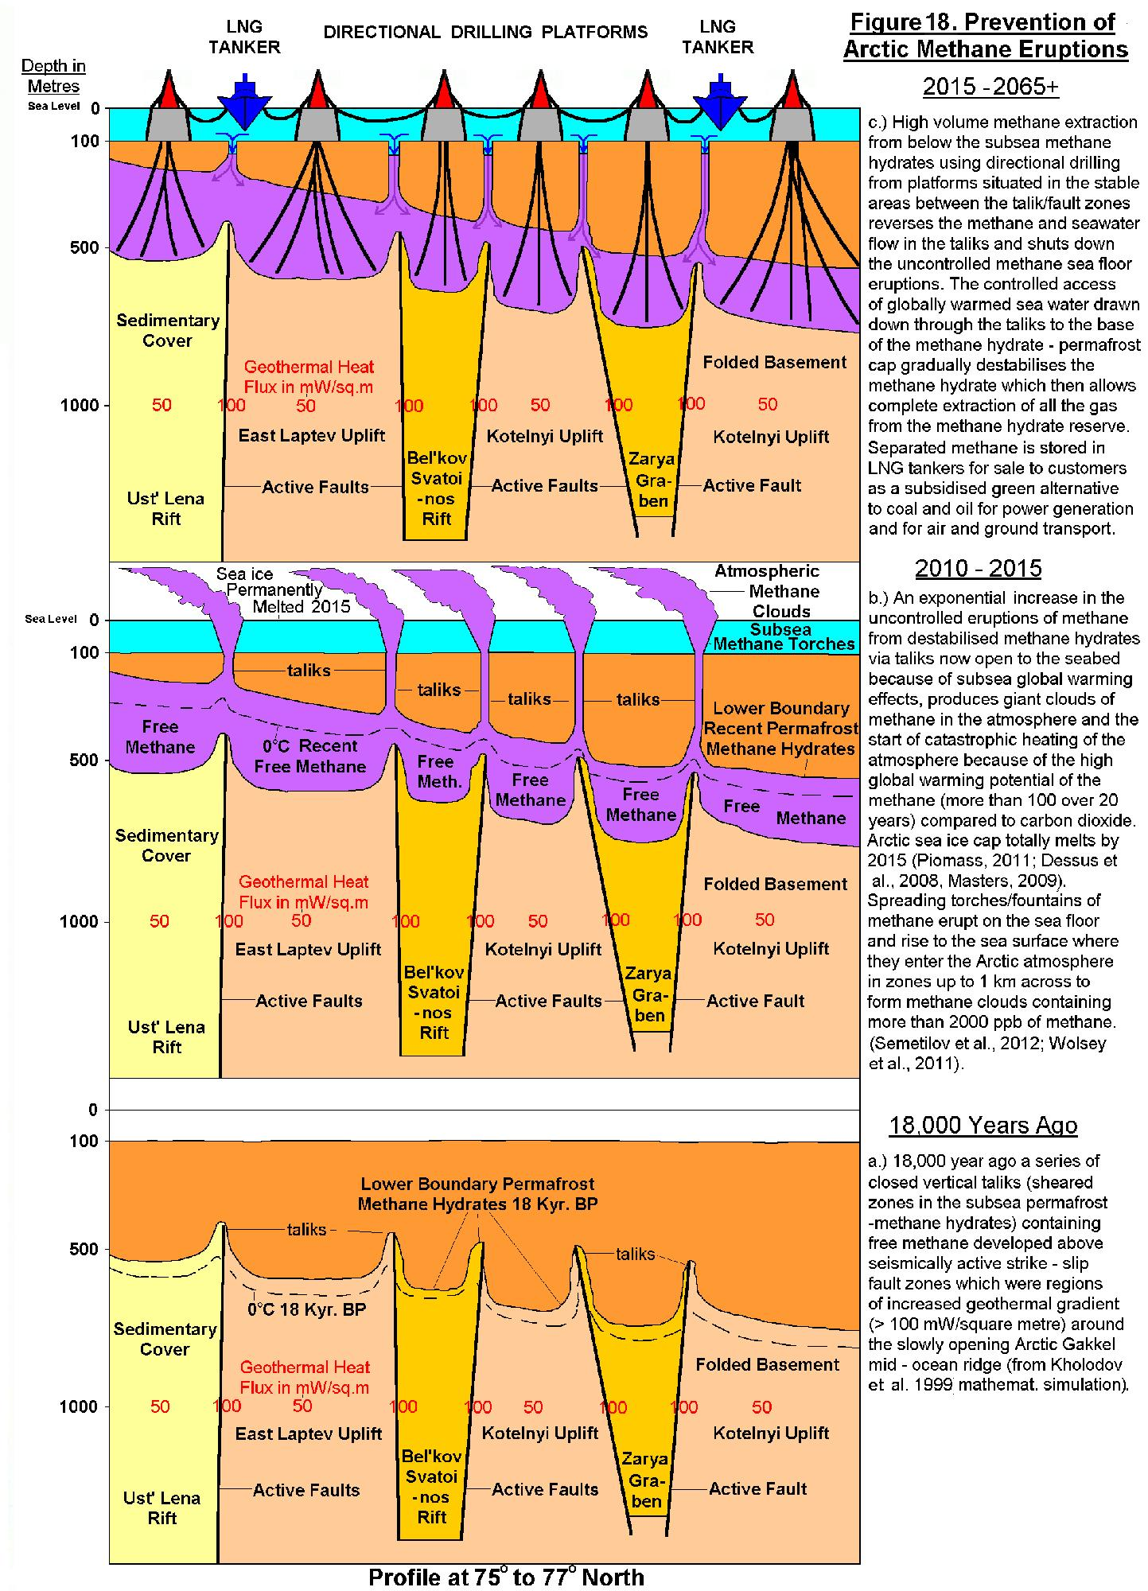

Slide 18
One small methane eruption zone occurs directly over the centre of the Gakkel Ridge and probably represents thermogenic deep seated methane being released by the magmatic heating of adjacent oil/gas fields by rising (pyroclastic) magma (Figure 9)(Edwards et al. 2001). This surface gas eruption appears to only represent a tiny percentage of the total gas released from other sources such as methane hydrates, as do methane eruptions around Cenozoic volcanics offshore Tiksi on the East Siberian shelf (Figure 11 and Figure 16).

Slide 20
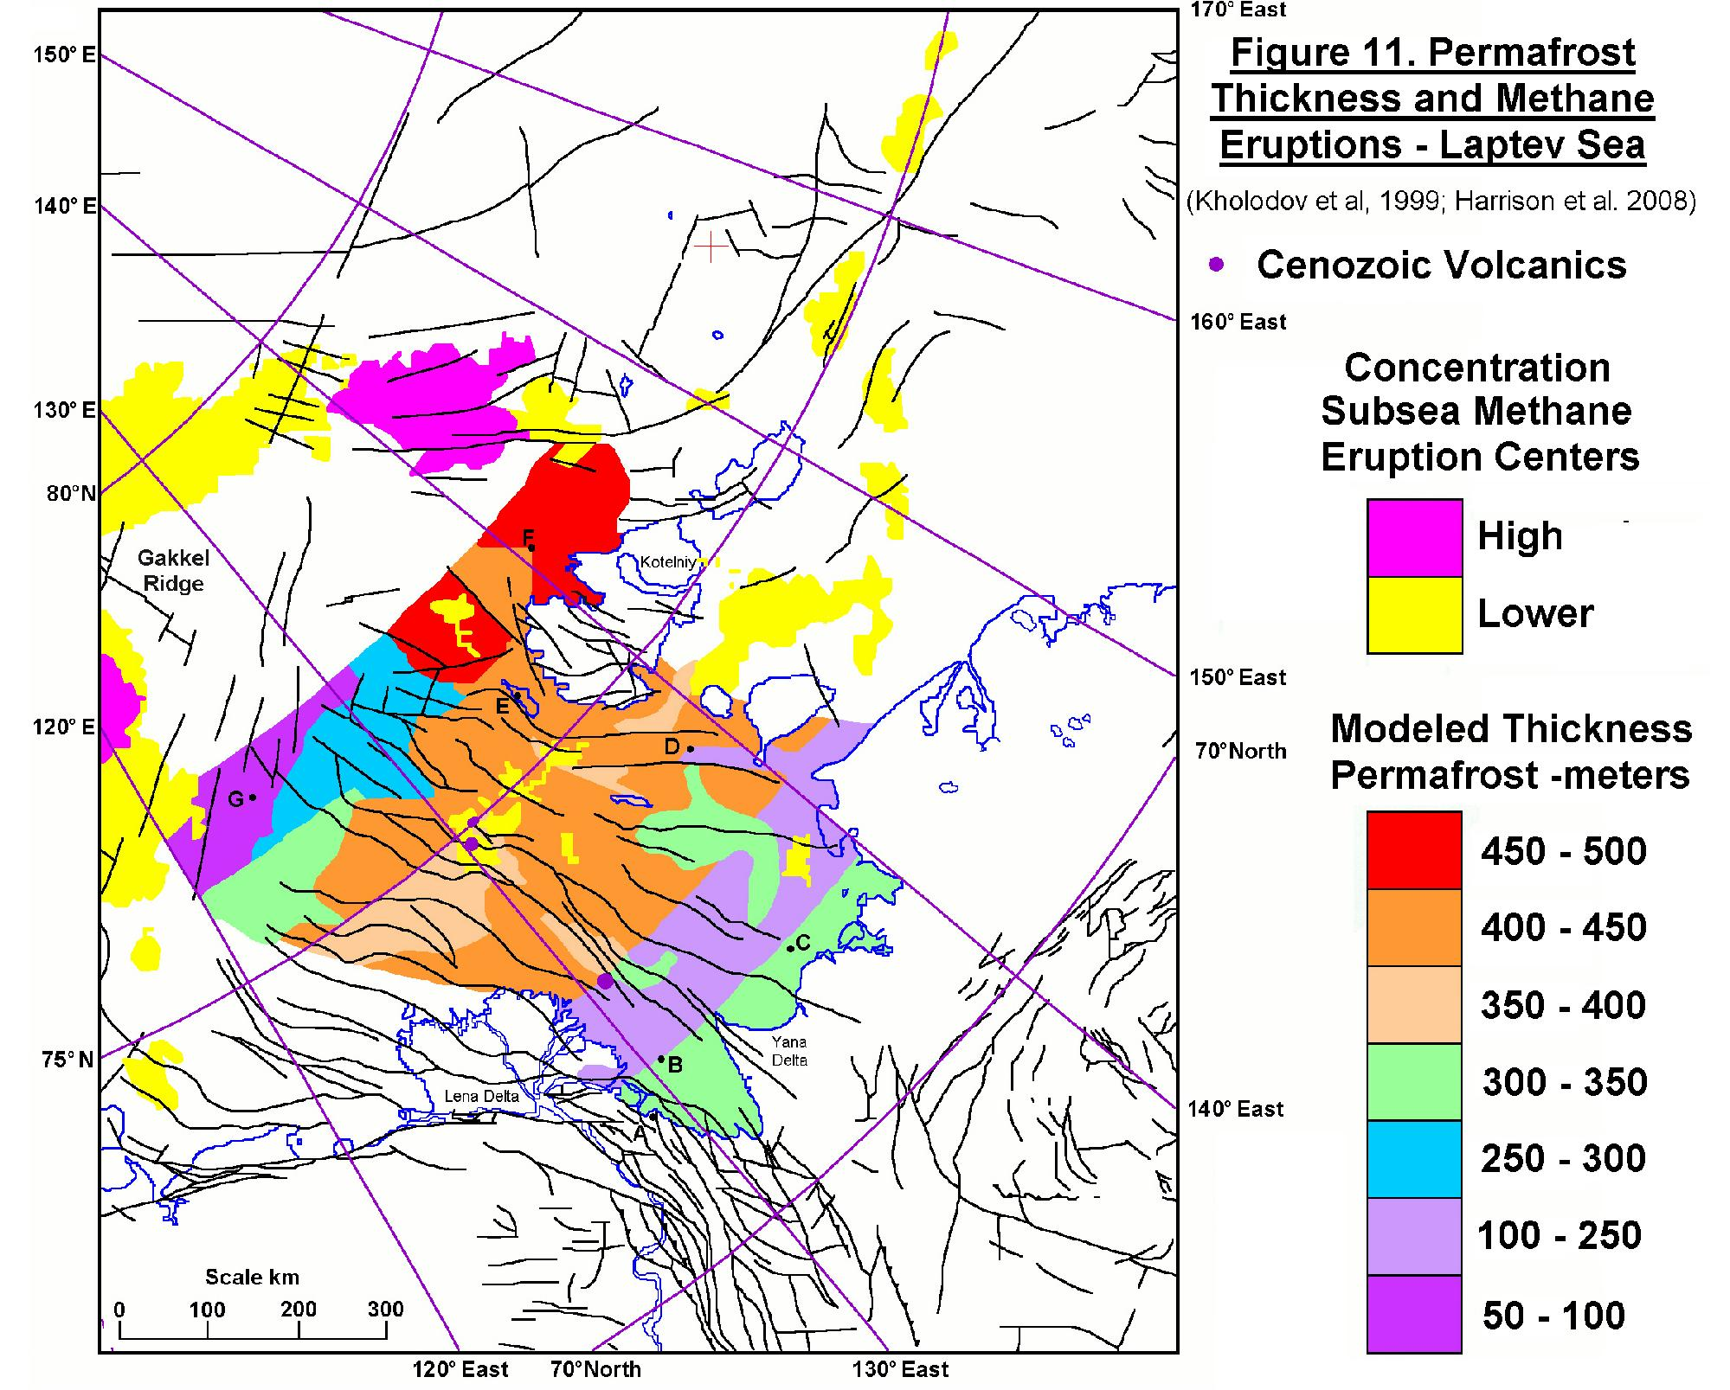

Slide 22
An elongated set of methane eruption zones occur on the submarine slope north of Svalbard flanking the Gakkel Ridge and result from methane hydrate decomposition caused by sudden changes in pressure and temperature conditions due to submarine slides/slumps (Figure 9). These submarine slides/slumps were evidently set off by seismic activity along the Gakkel Ridge which lies a short distance to the north in an area where the ridge opening is the widest (Figure 16). This may be similar to the Storegga slide (Light and Solana, 2002; NGI, 2012).

Slide 25
Light and Solana (2002) predicted that the western slopes of Norway and along the Barents Sea to Svalbard, would be especially vulnerable to slope failures in regions of unstable methane hydrate. Here the slowly spreading Gakkel Ridge runs as close as 30 km to the slope. Earthquake activity along the Gakkel Ridge often has magnitudes greater than 4 to 6 at depths shallower than 10 km (Avetisov, 2008) and will also be destabilizing the already unstable methane hydrates here leading to eruptions of methane into the atmosphere (Figure 9 and Figure 16).

Slide 28
There are some 1000 Gt to 1400 Gt (10^9 tonnes) of carbon contained in the methane hydrates on the East Siberian Arctic Shelf and 700 Gt of free methane is trapped under the Arctic submarine permafrost (Shakova et al. 2008, 2010). Shakova et al. estimate that between 5% to 10% of the subsea permafrost (methane hydrates) in that region is now punctured allowing methane to escape at a rate of about 0.5 Mt (500,000 tonnes) a year and that up to 50 Gt (10^9 tonnes) could be released abruptly at any time soon. Release of this subsea Arctic methane would increase the worldwide atmospheric methane content about 12 times equivalent to doubling the carbon dioxide content of the atmosphere.

Slide 29
This "methane hydrate gun", which is cocked and ready to fire at any moment, is an extremely serious scenario that will cause abrupt climate change (CCSP, 2008; IMPACTS 2008). Even if this subsea volume of Arctic methane is released over a longer interval of some ten to twenty years it will still result in a massive feedback on global warming and drive the Earth on an irretrievable plunge into total extinction.

Slide 30
After 2015, when the Arctic Ocean becomes navigable (Figure 5. Piomass in Naumer, 2012) it will be possible to set up a whole series of drilling platforms adjacent to, but at least 1 km away from the high volume methane eruption zones and to directionally drill inclined wells down to intersect the free methane below the sealing methane hydrate permafrost cap within the underlying fault network (Figure 18).

Slide 31
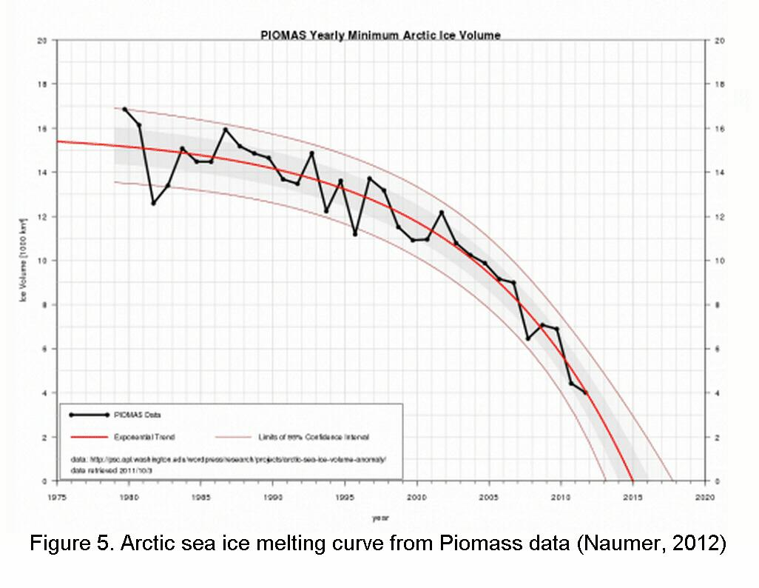

Slide 32
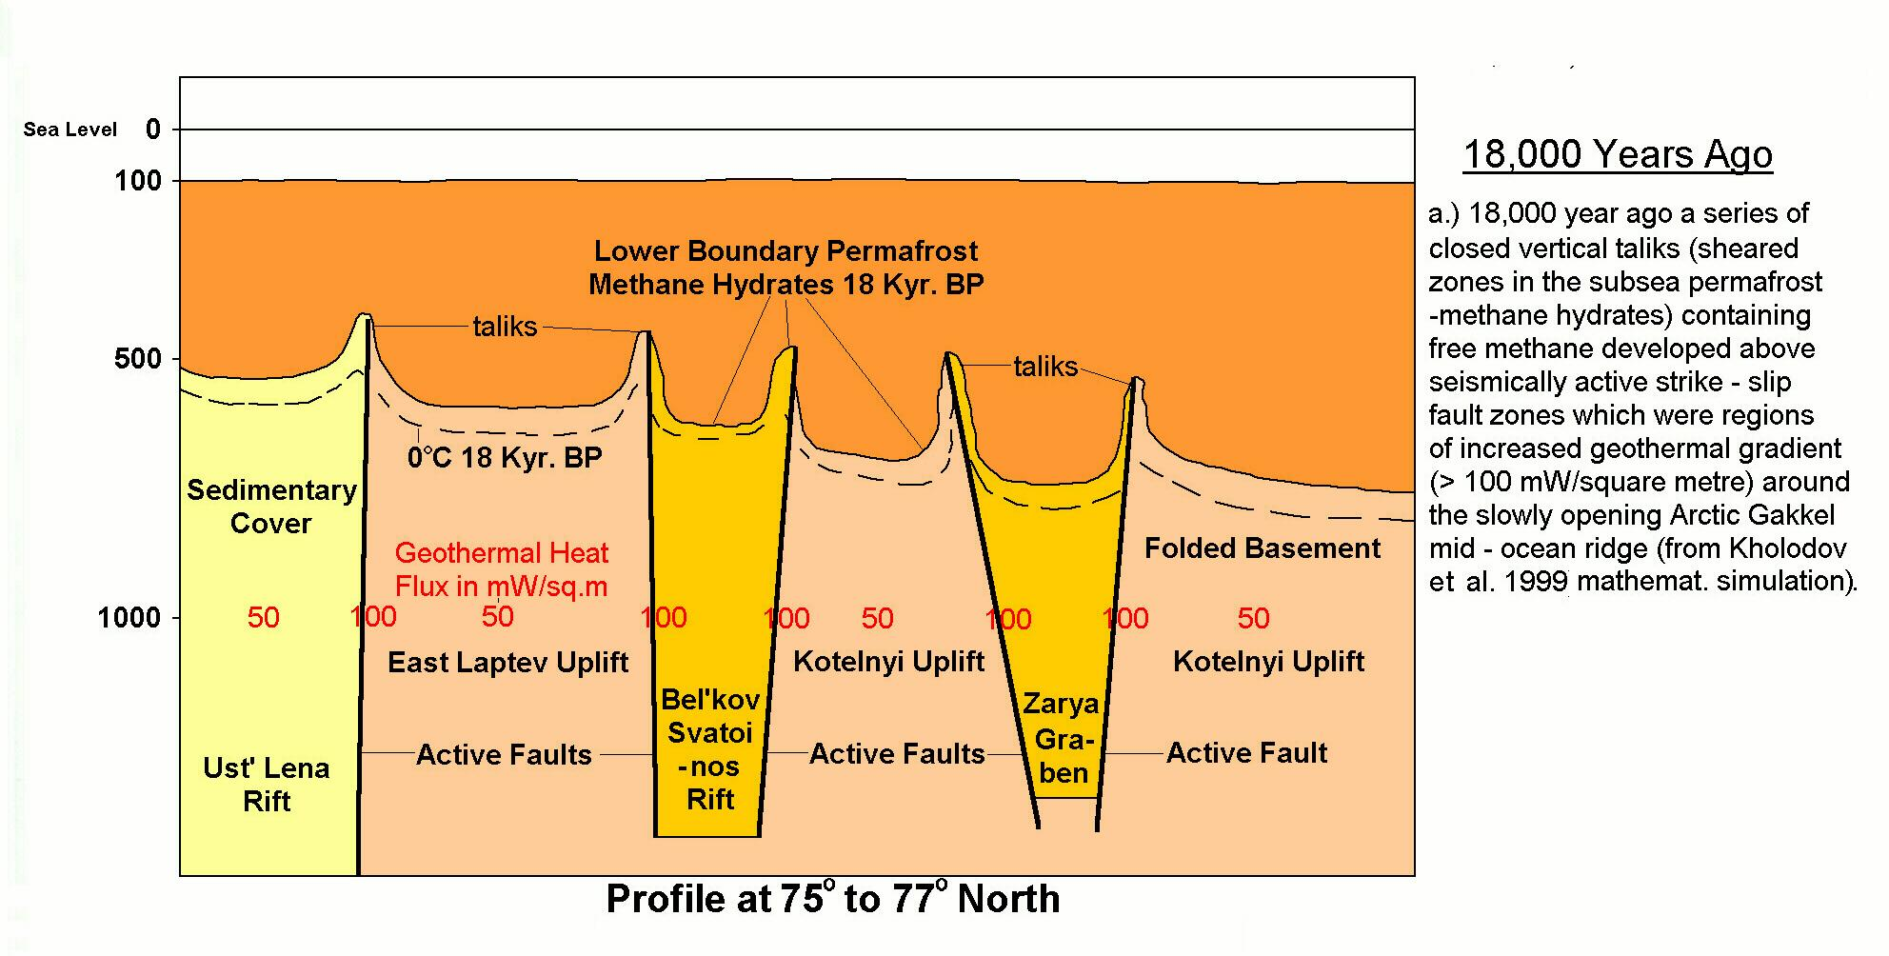

Slide 33
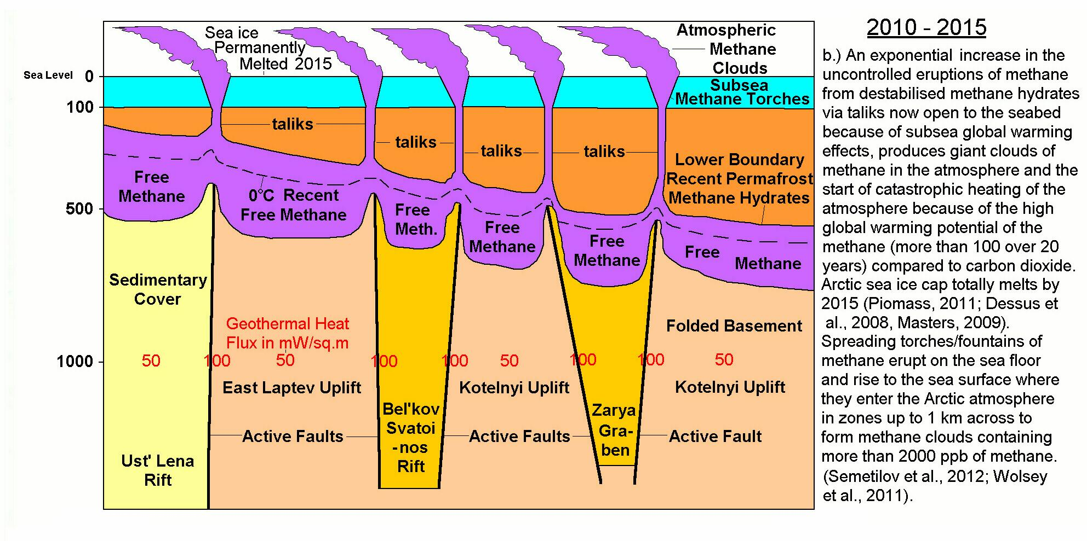

Slide 34
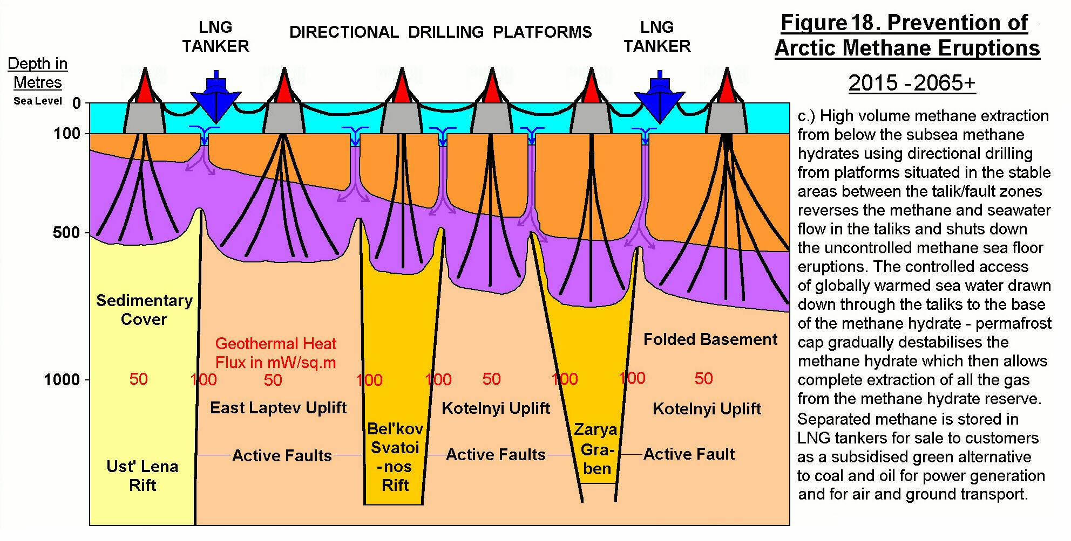

Slide 35
High volume methane extraction from below the subsea methane hydrates using directional drilling from platforms situated in the stable areas between the talik/fault zones will reverse the methane and seawater flow in the taliks and shut down the uncontrolled methane sea water eruptions (Figure18). The controlled access of globally warmed sea water drawn down through the taliks to the base of the methane hydrate - permafrost cap will gradually destabilize the underlying methane hydrate and allows complete extraction of all the gas from the methane hydrate reserve (Figure18).

Slide 37
The methane extraction boreholes can be progressively opened at shallower and shallower levels as the subterranean methane hydrate decomposes allowing the complete extraction of the sub permafrost reserve (Figure18).The methane and seawater will be produced to the surface where the separated methane will be processed in Floating Liquefied Natural Gas (FLNG) facilities and stored in LNG tankers for sale to customers as a subsidised green alternative to coal and oil for electric power generation, air and ground transport, home heating and cooking and the manufacture of hydrogen, fertilizers, fabrics, glass, steel, plastics, paint and other products.

Slide 39
Where the trapped methane is sufficiently geopressured within the fault system network underlying the Arctic subsea permafrost and is partially dissolved in the water (Light, 1985; Tyler, Light and Ewing, 1984; Ewing, Light and Tyler, 1984) it may be possible to coproduce it with the seawater which would then be disposed of after the methane had been separated from it for storage (Jackson, Light and Ayers, 1987; Anderson et al., 1984; Randolph and Rogers, 1984; Chesney et al., 1982).

Slide 40
Many methane eruption zones occur along the narrow fault bound channels separating the complex island archipelago of Arctic Canada (Figure 6 and 9). In these regions drilling rigs could be located on shore or offshore and drill inclined wells to intersect the free methane zones at depth beneath the methane hydrates, while the atmospheric methane clouds could be partly eliminated by using a beamed interfering radio transmission system (Lucy Project) (Light 2011a). A similar set of onshore drilling rigs could tap subpermafrost methane along the east coast of Novaya Zemlya (Figure 6 and 9).

Slide 41
Methane is a high energy fuel, with more energy than other comparable fossil fuels (Wales 2012). As a liquid natural gas it can be used for electric power generation, road transport, jet aircraft and rocket fuel and produces little pollution compared to coal, gasoline and other hydrocarbon fuels. Support should be sought from the United nations, World Bank, national governments and other interested parties for a subsidy (such as a tax rebate) of some 5% to 15% of the market price on Arctic permafrost methane and its derivatives to make it the most attractive LNG for sale compared to LNG from other sources.

Slide 42
This will guarantee that all the Arctic gas recovered from the Arctic methane hydrate reservoirs and stockpiled, will immediately be sold to consumers and converted into safer byproducts. This will also act as an incentive to oil companies to produce methane in large quantities from the Arctic methane hydrate reserves. In this way the Arctic methane hydrate reservoirs will be continuously reduced in a safe controlled way over the next 200 to 300 years supplying an abundant "Green LNG" energy source to humanity.

Slide 43
Proposer:-
Malcolm P.R. Light, PhD, University of London
Arctic Methane Emergency Group
Editor:-
Sam Carana
Arctic Methane Emergency Group
Public Relations:-
Harold Hensel
Arctic Methane Emergency Group

